Slide 1
Movie Recommendation System
Submitted in the partial fulfillment for the award of the degree of
BACHELOR OF ENGINEERING
IN
Computer Science(Big Data Analytics)
Submitted by:
Saksham , Anjali , Tanishka
19BCS3820,19BCS3796,19BCS3819
Under the Supervision of:
SEEMA BARDA
Department of AIT-CSE
DISCOVER . LEARN . EMPOWER

Slide 2
Outline
Introduction to Project
Problem Formulation
Objectives of the work
Methodology used
Results and Outputs
Conclusion
Future Scope
References

Slide 3
Introduction to Project
What is a Recommendation System?
Recommendation System is a filtration program whose prime goal is to predict the “rating” or “preference” of a user towards a domain-specific item or item. In our case, this domain-specific item is a movie, therefore the main focus of our recommendation system is to filter and predict only those movies which a user would prefer, given some data about the user himself or herself.

Slide 4
Movie recommendation systems provide a mechanism to assist users in classifying users with similar interests. This makes recommender systems essentially a central part of websites and e-commerce applications.
Content-based Filtering:-This filtration strategy is based on the data provided about the items. The algorithm recommends products that are similar to the ones that a user has liked in the past. This similarity (generally cosine similarity) is computed from the data we have about the items as well as the user’s past preferences.
So what happens here is that the recommendation system checks the past preferences of the user and find the film “The Prestige”, then tries to find similar movies to that using the information available in the database such as the lead actors, the director, genre of the film, production house, etc and based on this information find movies similar to “The Prestige”.

Slide 5
Problem Formulation
Why Recommendation systems?
They help the user find items of their interest
Helps the item provider to deliver their items to the right user
To identify the most relevant products for each user
Showcase personalized content to each user
Suggest top offers and discounts to the right user
Websites can improve user-engagement
It increases revenues for business through increased consumption

Slide 6
Objectives
This makes recommender systems essentially a central part of websites and e-commerce applications.
The purpose of a recommendation system basically is to search for content that would be interesting to an individual.
Recommendation systems are Artificial Intelligence based algorithms that skim through all possible options and create a customized list of items that are interesting and relevant to an individual.
These results are based on their profile, search/browsing history, what other people with similar traits/demographics are watching, and how likely are you to watch those movies.

Slide 7
Methodology used
Content Based Recommender System recommends movies similar to the movie user likes and analyses the sentiments on the reviews given by the user for that movie.
The details of the movies(title, genre, runtime, rating, poster, etc) are fetched using an API by TMDB, https://www.themoviedb.org/documentation/api, and using the IMDB id of the movie in the API, We did web scraping to get the reviews given by the user in the IMDB site using beautifulsoup4 and performed sentiment analysis on those reviews.
Similarity Score :
How does it decide which item is most similar to the item user likes? Here we use the similarity scores.

Slide 8
It is a numerical value ranges between zero to one which helps to determine how much two items are similar to each other on a scale of zero to one. This similarity score is obtained measuring the similarity between the text details of both of the items. So, similarity score is the measure of similarity between given text details of two items. This can be done by cosine-similarity.

Slide 9
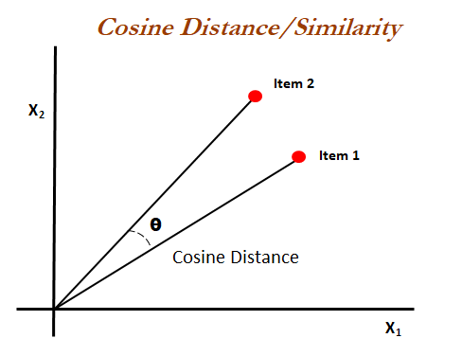
How Cosine Similarity works?
Cosine similarity is a metric used to measure how similar the documents are irrespective of their size. Mathematically, it measures the cosine of the angle between two vectors projected in a multi-dimensional space. The cosine similarity is advantageous because even if the two similar documents are far apart by the Euclidean distance (due to the size of the document), chances are they may still be oriented closer together. The smaller the angle, higher the cosine similarity.

Slide 10
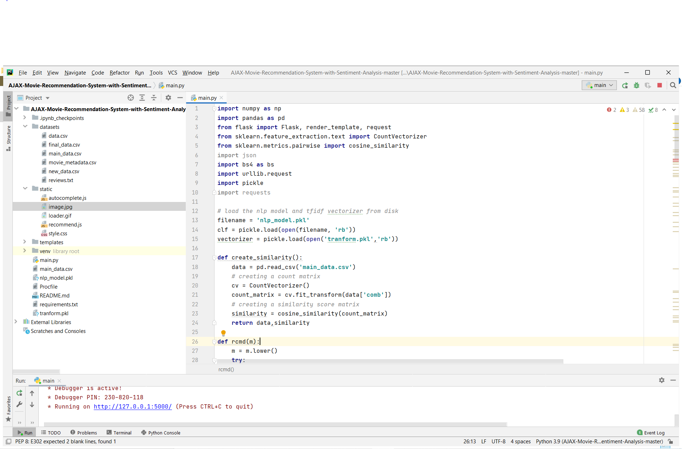
Results and Outputs
CODE SUCCESSFULLY COMPILED-
LOCAL HOST LINK: IT WILL OPEN
WEB APPLICATION

Slide 11
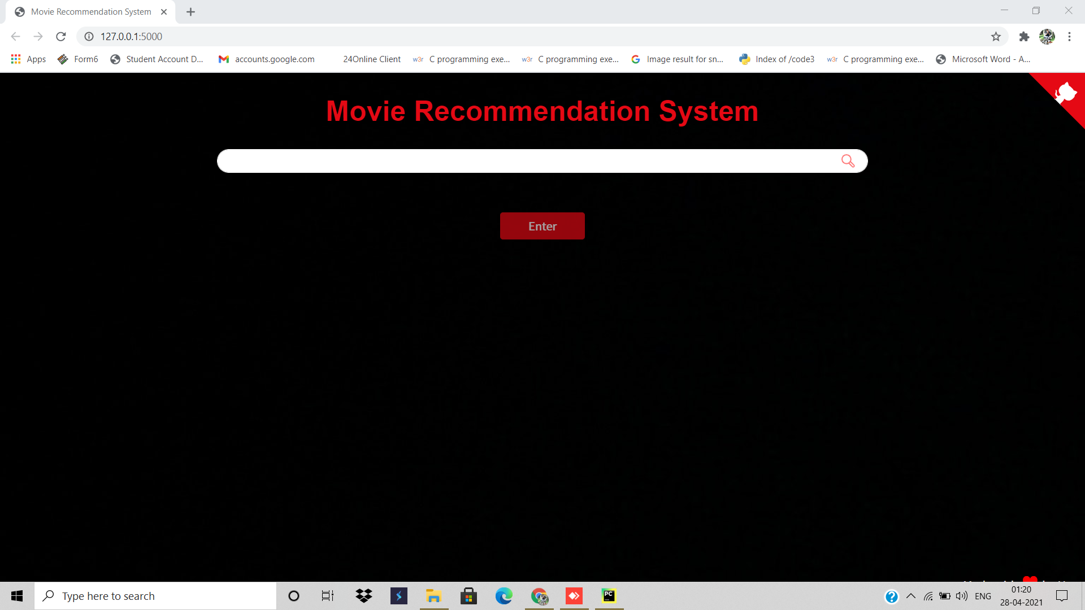
WEB APPLICATION
TYPE THE NAME OF ANY MOVIE YOU WANT TO SEARCH AND THEN CLICK ON ENTER.

Slide 12
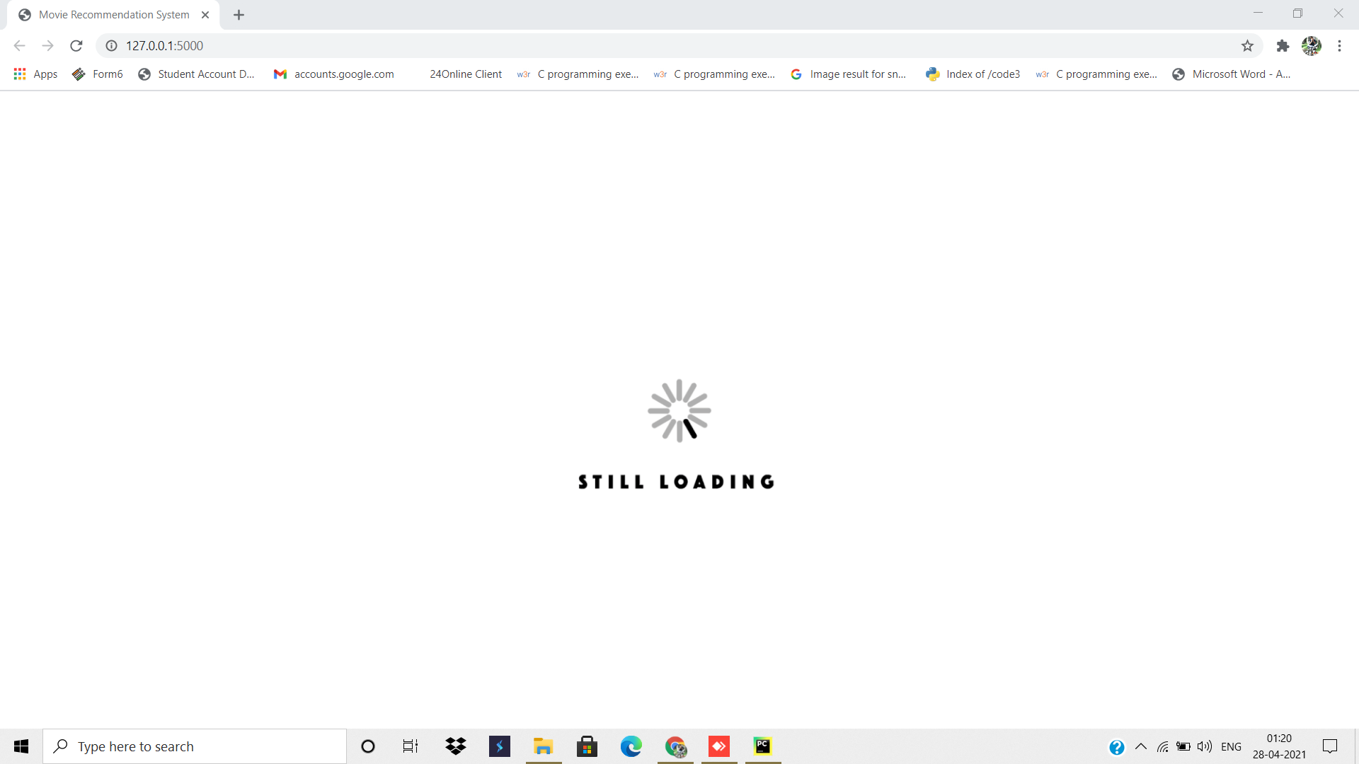
LOADING SCREEN
GRAB 🍿AND DRINK

Slide 13
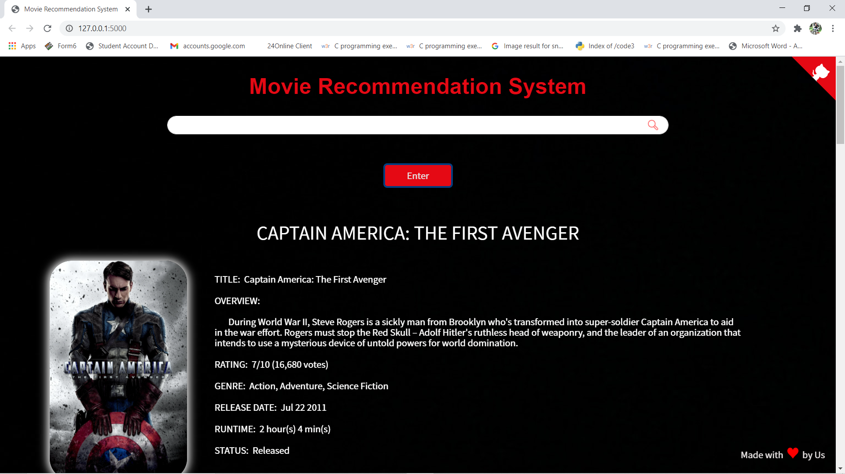
SEARCHED MOVIE APPEARS
I SEARCHED FOR CAPTAIN AMERICA
ALL THE DETAILS OF THE MOVIE APPEARED.

Slide 14
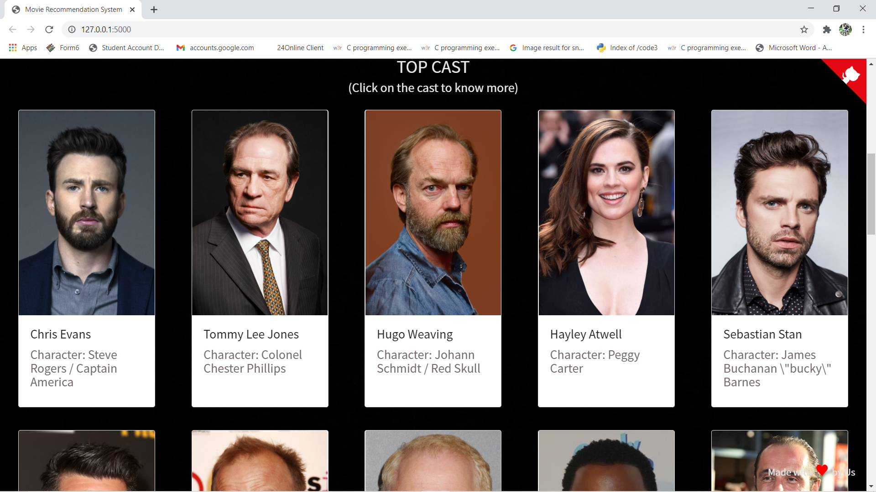
CAST DETAILS

Slide 15
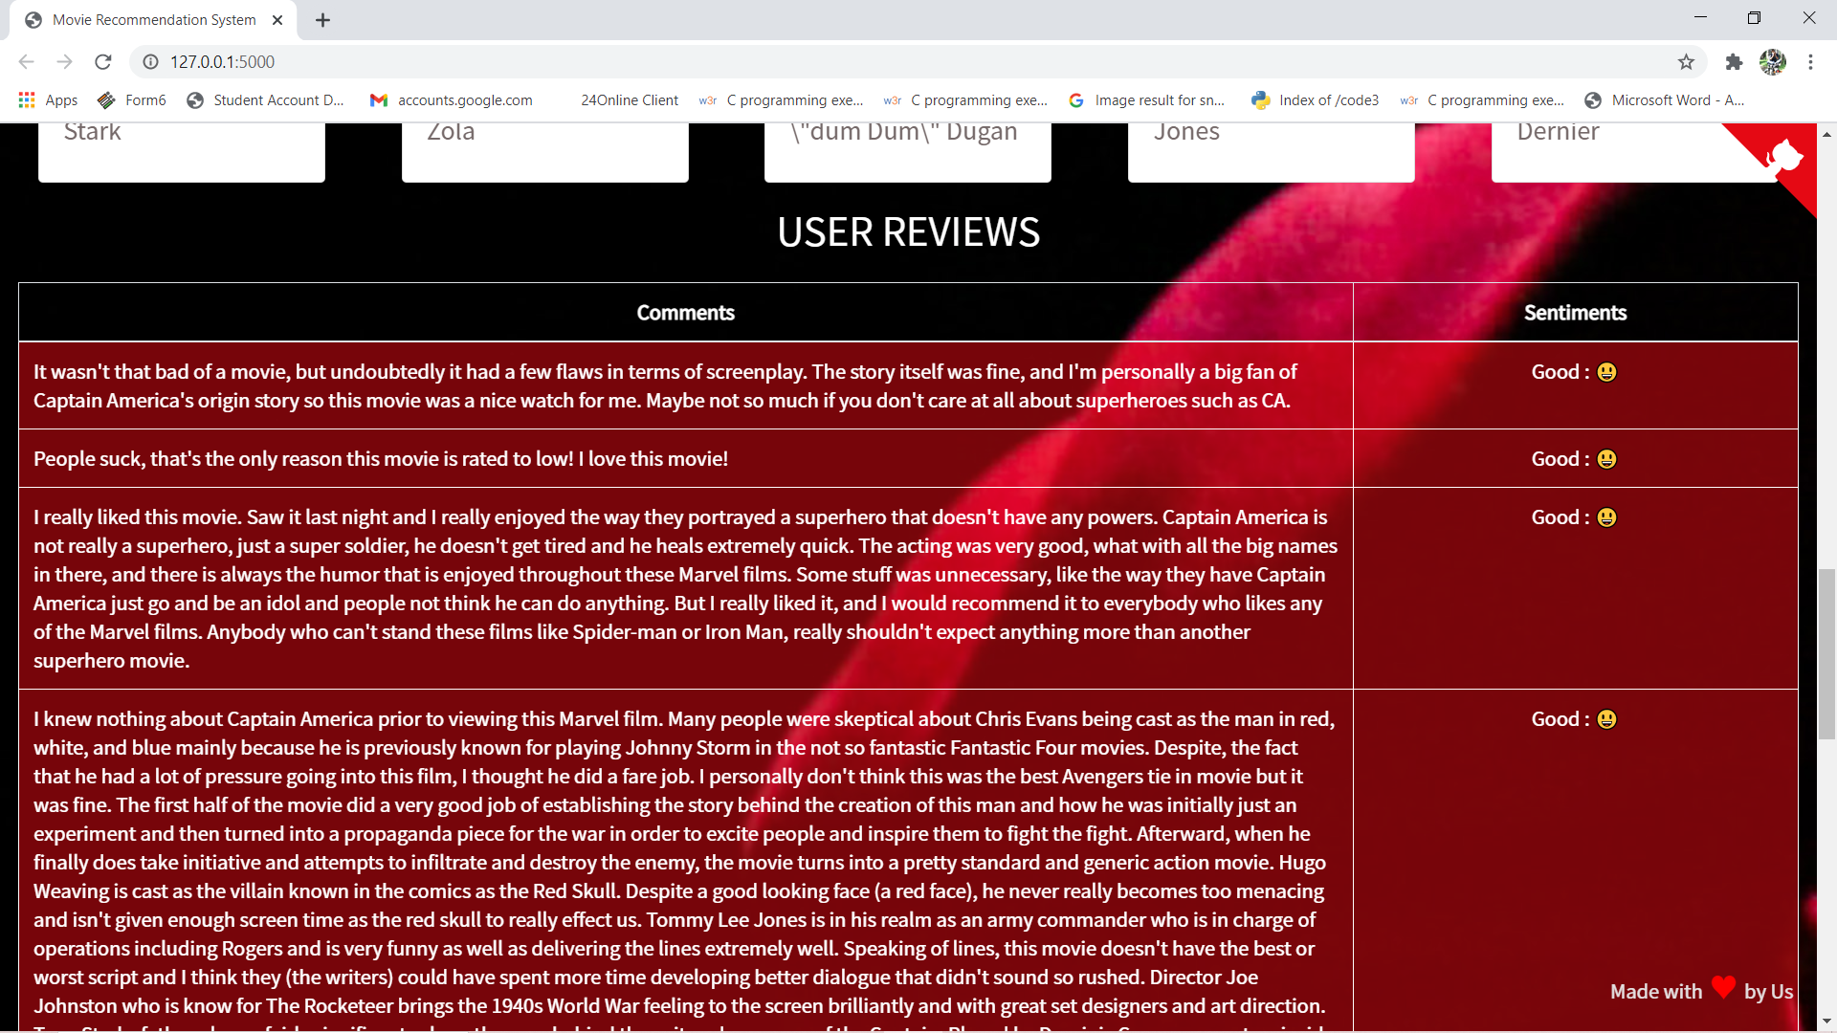
USER REVIEWS:-

Slide 16
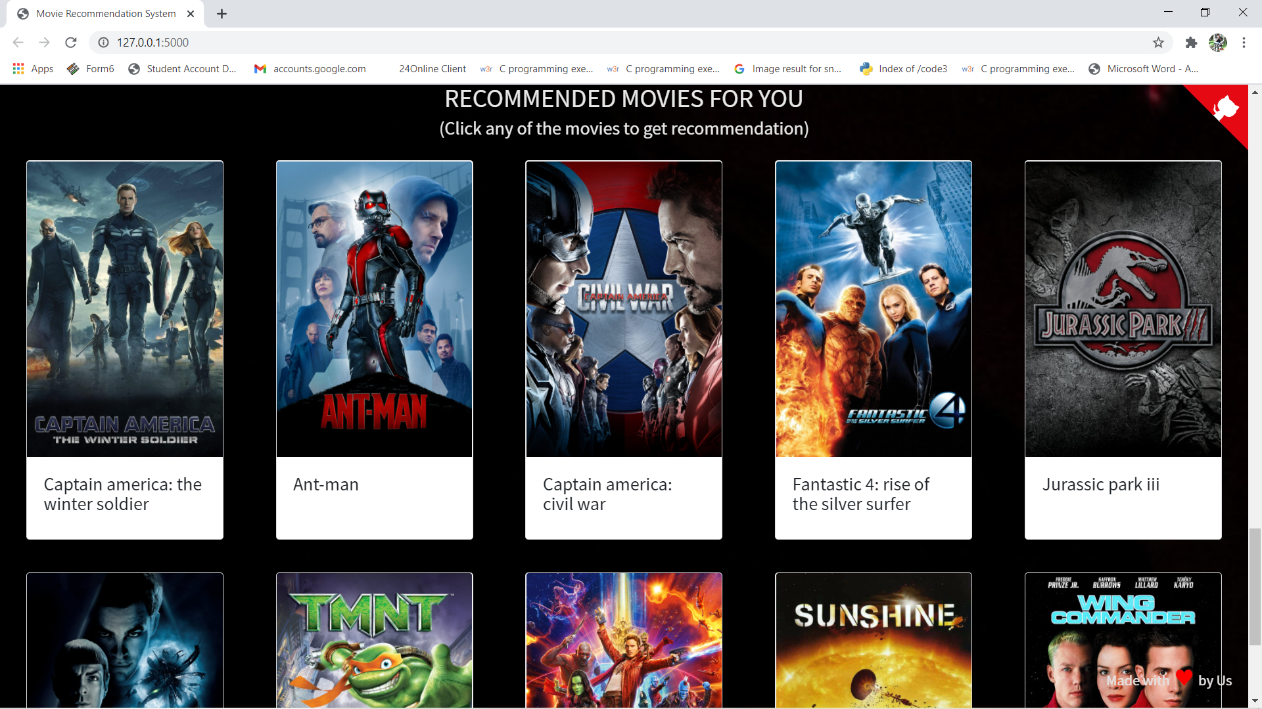
RECOMMENDED MOVIES ON THE BASIS OF YOUR SEARCHED MOVIE

Slide 17
Conclusion
We would conclude by stating that we hope you have got a basic idea of how this recommendation system works. We have discussed mainly one recommendation systems that was content based whereas there are several other systems that are used for recommendation purposes like Collaborative filtering, Hybrid models, also neural networks based approaches. Recommendation systems are very effective systems that are tremendous. People are trying to implement recommendations in various different applications.

Slide 18
Future Scope
In future we can work on hybrid recommender using clustering and similarity for better performance. Our approach can be further extended to other domains to recommend songs, video, venue, news, books, tourism and e-commerce sites, etc.

Slide 19
References
D. Rattan, R. Bhatia, and M. Singh, “Software clone detection: A systematic review,”
Information and Software Technology, vol. 55, no. 7, pp. 1165–1199, Jul. 2013.
J. F. Islam, M. Mondal, and C. K. Roy, “Bug Replication in Code Clones: An Empirical Study,” in 2016 IEEE 23rd International Conference on Software Analysis, Evolution, and Reengineering (SANER), 2016, pp. 68–78.
M. R. Islam and M. F. Zibran, “A Comparative Study on Vulnerabilities in Categories of Clones and Non-cloned Code,” in 2016 IEEE 23rd International Conference on Software Analysis, Evolution, and Reengineering (SANER), 2016, pp. 8–14.
M. R. Islam, M. F. Zibran, and A. Nagpal, “Security Vulnerabilities in Categories of Clones and Non-Cloned Code: An Empirical Study,” in 2017 ACM/IEEE International Symposium on Empirical Software Engineering and Measurement (ESEM), 2017, pp. 20–29.
C. K. Roy, M. F. Zibran, and R. Koschke, “The vision of software clone management: Past, present, and future (Keynote paper),” in 2014 Software Evolution Week - IEEE Conference on Software Maintenance, Reengineering, and Reverse Engineering (CSMR-WCRE), 2014, pp. 18–33.
J. Krinke, “A Study of Consistent and Inconsistent Changes to Code Clones,” in 14th Working Conference on Reverse Engineering (WCRE 2007), 2007, pp. 170–178.
D. Chatterji, J. C. Carver, N. A. Kraft, and J. Harder, “Effects of cloned code on software maintainability: A replicated developer study,” in 2013 20th Working Conference on Reverse Engineering (WCRE), 2013, pp. 112–121.

Slide 20
D. Rattan, R. Bhatia, and M. Singh, “An Empirical Study of Clone Detection in MATLAB/ Simulink Models,” International Journal of Information and Communication Technology.
D. Rattan, R. Bhatia, and M. Singh, “Detecting High Level Similarities in Source Code and Beyond,” International Journal of Energy, Information and Communications, vol. 6, no. 2, pp. 1–16, 2015.
D. Rattan, R. Bhatia, and M. Singh, “Detection and Analysis of Clones in UML Class Models,” International Journal of Software Engineering, IJSE, vol. 8, no. 2, pp. 66– 99, 2015.
D. Rattan, R. Bhatia, and M. Singh, “Model clone detection based on tree comparison,” in 2012 Annual IEEE India Conference (INDICON), 2012, pp. 1041– 1046.
C. K. Roy and J. R. Cordy, “NICAD: Accurate Detection of Near-Miss Intentional Clones Using Flexible Pretty-Printing and Code Normalization,” in 2008 16th IEEE International Conference on Program Comprehension, 2008, pp. 172–181.
M. Mondal, C. K. Roy, and K. A. Schneider, “SPCP-Miner: A tool for mining code clones that are important for refactoring or tracking,” in 2015 IEEE 22nd International Conference on Software Analysis, Evolution, and Reengineering (SANER), 2015, pp. 484–488.

Slide 21
THANK YOU!

